Slide 1

Tutorial: Star-CCM+ CFD
Eneko Lazpita
ModelFLOWs
Cardiac

Slide 2



Step 0: Prerequisites
Matlab with STL management packages.
Star-CCM+
STL files in end systole and in end diastole (max. and min. volumes)
Step 0.1: Load given .sim file
Setup of this tutorial done.
Step 0.2: Run create_necessary_files.m
We create the initial scaled mesh (if necessary) and the tables we need for boundary conditions: inlet, outlet, wall movement.
ModelFLOWs
Cardiac

Slide 3
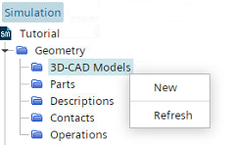
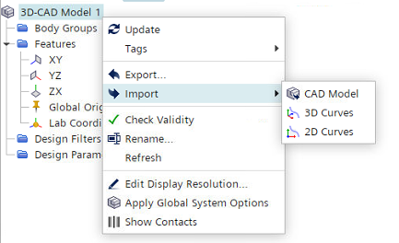
Step 1.1: Load Geometry
Create geometry using Geometry → 3D-CAD Models → New
Right click in 3D-CAD Model 1 → Import -> CAD Model → Select your scaled initial mesh.
Close 3D-CAD
ModelFLOWs
Cardiac
Geometry

Slide 4
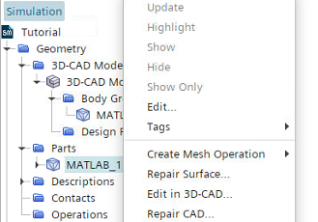
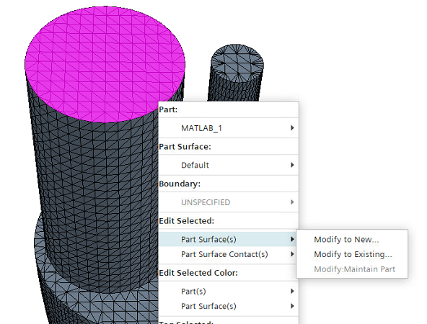
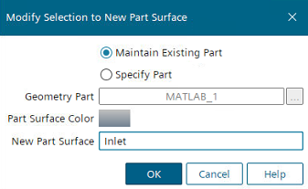
Step 1.2: Create Part & Boundaries
Inside the Body Groups Created right click on your body → New Geometry Part… → OK
Rename Part: Ventricle
Geometry → Parts → Right click in Ventricle → Repair Surface… → OK
Select boundary zone (double left click if your geometry has sharp edges around)
Right click on selected surface -> Edit Selected: Part Surface(s) → Modify to New… → Introduce boundary name (Inlet, Outlet, Wall)
Close
ModelFLOWs
Cardiac
Geometry

Slide 5
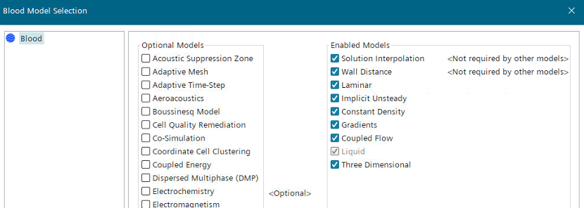
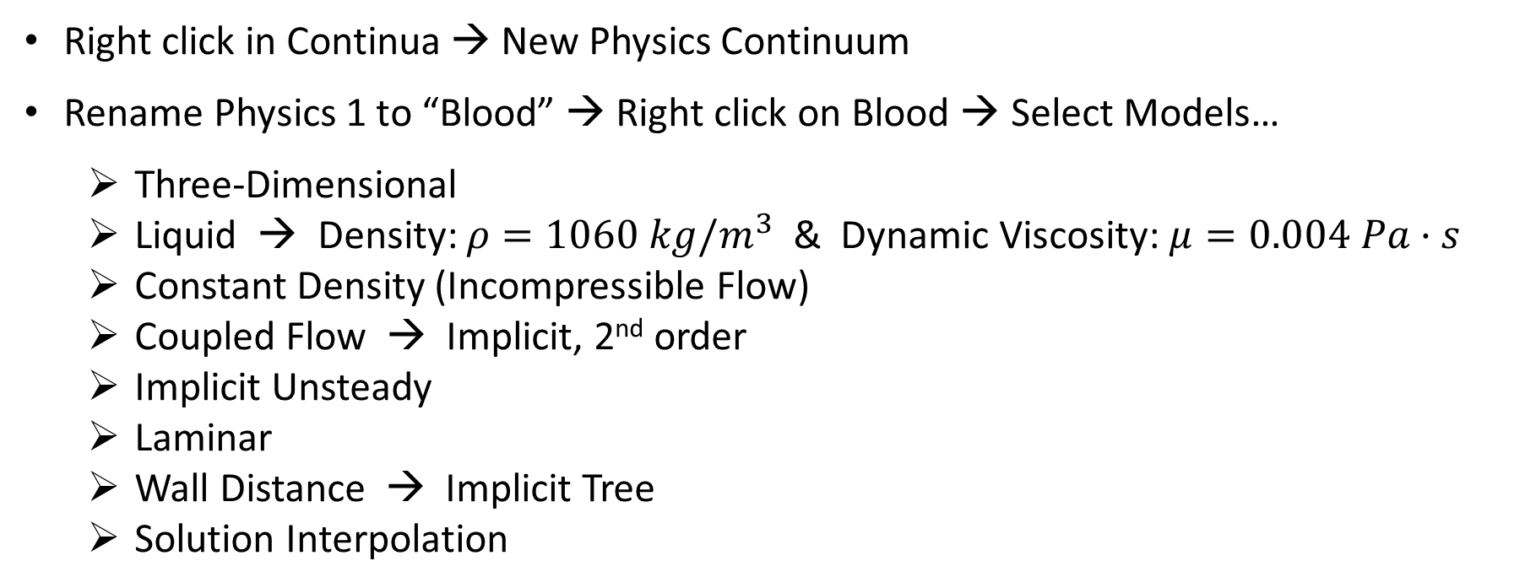
Step 2.1: Create Continua
Right click in Continua → New Physics Continuum
Rename Physics 1 to “Blood” → Right click on Blood → Select Models…
Three-Dimensional
Liquid → Density: $ρ=1060 kg/m^{3}$ & Dynamic Viscosity: $μ=0.004 Pa·s$
Constant Density (Incompressible Flow)
Coupled Flow → Implicit, 2nd order
Implicit Unsteady
Laminar
Wall Distance → Implicit Tree
Solution Interpolation
ModelFLOWs
Cardiac
Simulation Setup

Slide 6
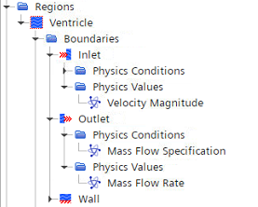
Step 2.2: Create Region
Right click in Geometry → Parts → “Your body name” → Set New Region… → Introduce name “ Ventricle”
Regions → Ventricle → Right click in Boundaries → New
Rename boundary; Select corresponding Part Surface; Choose Type
Inlet: type Velocity Inlet →Physics Values → Introduce velocity profile (explained next)
Outlet: type Outlet → Physics Conditions → Mass Flow Specification → Mass Flow Rate → Physics Values → Introduce mass flow profile (explained next)
Wall: type Wall
ModelFLOWs
Cardiac
Simulation Setup

Slide 7
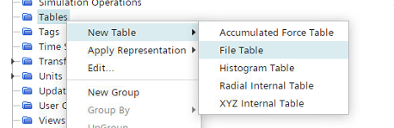
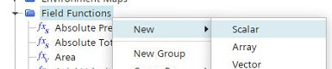
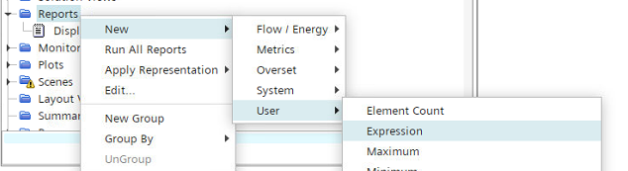
Step 2.3: Import Data Tables
Tools → Right click in Tables → New Table → File Table→ Load:
XYZ_displacement.csv
Incremental_VolumeVariation_DT-%.csv
InletVelocity_DT-%.csv
OutletFlowRate_DT-%.csv
Tools → Right click in Field Functions → New → Scalar:
Change function name: Inlet_Velocity, Outlet_FlowRate
Introduce dimensions: [Velocity 1], [Length 3, Time -1]
Interpolate tables: interpolateTablePeriodic(@Table("InletVelocity_DT-5e-04"), “t", LINEAR, “velin", ${Time},1,0) interpolateTablePeriodic(@Table(“OutletFlowRate_DT-5e-04"), “t", LINEAR, “fRout", ${Time},1,0)
Right click in Reports → New → User → Expression
Change function name: Displacement_Interpolation
Introduce dimensions: [Length 1]
Interpolate tables: interpolateTablePeriodic(@Table("Incremental_VolumeVariation_DT-5e-04"), "t", LINEAR, "dVol", ${Time},1,0)
ModelFLOWs
Cardiac
Simulation Setup

Slide 8
Step 2.4: Define Inlet & Outlet BCs
Tools → Right click in Parameters → New → Scalar:
Define necessary parameters: R_Inlet = 0.012 m; C_Inlet = 0.006 m
Tools → Right click in Field Functions → New → Scalar:
Define inlet radial coordinate: Inlet_RadialCoordinate = sqrt(pow($${Position}[0]+${C_inlet},2)+pow($${Position}[2],2)) [m]
Define BC profiles: Inlet_Velocity_Tanh = 1.0745*tanh(5*(1-${Inlet_RadialCoordinate}/${R_Inlet})) * ${Inlet_Velocity} [m/s] Outlet_MassFlowRate = ${Outlet_FlowRate} * ${Density} [kg/s]
Regions → Ventricle → Boundaries → Inlet → Physics Values → Velocity Magnitude
Field Function → Inlet_Velocity_Tanh
Regions → Ventricle → Boundaries → Outlet → Physics Values → Mass Flow Rate
Field Function → Outlet_MassFlowRate
ModelFLOWs
Cardiac
Simulation Setup

Slide 9
Step 3.1: Specify Motion
Tools → Right click in Motions → New → Morphing:
Morpher Order → Regionwise
Morpher Method → RBF
Geometry → Right click in Operations → New → Mesh → Automated Mesh
Surface Remesher
Tetrahedral Mesher
Prism Layer Mesher
ModelFLOWs
Cardiac
Moving Wall

Slide 10
Step 3.2.1: Function Data Mapper
Tools → Right click in Parameters → New → Scalar:
EDV = 1.4521E-4 m^3 ; pi = 4*atan(1)
b_ESV = 0.08 m ; b_EDV = pow((3.0/2.0/${pi}/pow(1/4,2) * ${EDV}),(1/3))
a_ESV = 1/4 * ${b_ESV} ; a_EDV = 1/4 * ${b_EDV}
tol_mesh = 1.0E-5 m ; R_Move = 0.018 m
Tools → Right click in Field Functions → New → Scalar:
Coordinate_Angular = atan2($${Position}[1],$${Position}[0])
Coordinate_Radial = sqrt(pow($${Position}[0],2)+pow($${Position}[1],2)) [m]
Displacement_Vertical = ($${Position}[2] > ${tol_mesh}) ? (${b_EDV}/${b_ESV}-1)*$${Position}[2] : 0 [m]
Displacement_Radial = ($${Position}[2] > ${tol_mesh}) ? (${a_EDV}/${a_ESV}-1)*${r_XY} : (abs($${Position}[2]) < ${tol_mesh} && ${r_XY}>=${R_Move}) ? (${a_EDV}-${a_ESV})/(${a_ESV}-${R_Move})*(${r_XY}-${R_Move}) : 0 [m]
ModelFLOWs
Cardiac
Moving Wall

Slide 11
Step 3.2.1: Function Data Mapper
Tools → Right click in Field Functions → New → Vector:
Displacement_Vector: [${Displacement_Radial}*cos(${phi_XY}), ${Displacement_Radial}*sin(${phi_XY}), ${Displacement_Vertical}] [m]
Tools → Right click in Data Mappers → New Data Mapper → Surface Data Mapper:
Source Surfaces → Regions: Ventricle: Wall
Vector Field Function → Select: Displacement_Vector
Target Specifications → Surface 1 → Target Entities → Regions: Ventricle: Wall
ModelFLOWs
Cardiac
Moving Wall

Slide 12
Step 3.2.2: Tabular Data Mapper
Tools → Right click in Data Mappers → New Data Mapper → Tabular Data Mapper:
Source Table → XYZ_displacement.csv
Source: Data → Select: Displacement[i], Displacement[j], Displacement[k]
Target Specifications → Surface 1 → Target Entities → Regions: Ventricle: Wall
ModelFLOWs
Cardiac
Moving Wall

Slide 13
Step 3.3: Map Data
Tools → Data Mappers → Right click in Surface Data Mapper 1 → Map Data OR → Right click in Tabular Data Mapper 1 → Map Data
Tools → Right click in Field Functions → New → Vector: Morpher_Entry = ${Displacement_Interpolation} * $${MappedVertexDisplacement_Vector} [m] OR Morpher_Entry = ${Displacement_Interpolation} * [${MappedVertexDisplacement[i]},${MappedVertexDisplacement[j]},${MappedVertexDisplacement[k]}] [m]
ModelFLOWs
Cardiac
Moving Wall

Slide 14
Step 3.4: Create Mesh Movement
Right click in Monitors → New Monitor → Field Sum
Rename: Sum_Displacement_X, Sum_Displacement_Y, Sum_Displacement_Z
Parts: Ventricle → Wall
Field Function: Morpher_Entry[i], Morpher_Entry[j], Morpher_Entry[k]
Tools → Right click in Field Functions → New → Vector: MorphSurfaceMesh_Entry = [${Sum_Displacement_XMonitor},${Sum_Displacement_YMonitor},${Sum_Displacement_ZMonitor}] [m]
ModelFLOWs
Cardiac
Moving Wall

Slide 15
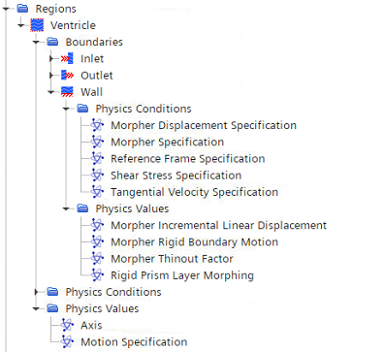
Step 3.5: Prepare Moving Wall Boundary
Regions → Ventricle → Physics Values → Motion Specification → Motion: Morphing
Regions → Ventricle → Boundaries → Wall
Physics Conditions → Morpher Specification: Displacement
Physics Conditions → Morpher Displacement Specification: Incremental
Physics Values → Morpher Incremental Linear Displacement → Field Function: Morpher_Entry
Incremental
Displacement
Field Function: Morpher_Entry
Morphing
ModelFLOWs
Cardiac
Moving Wall

Slide 16
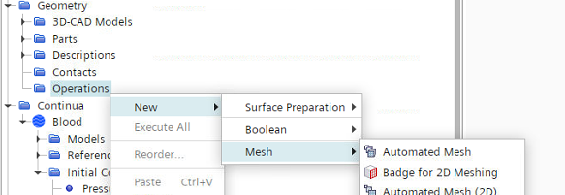
Step 4.1: Automated Mesh
Geometry → Right click in Operations → New → Mesh → Automated Mesh
Surface Remesher
Tetrahedral Mesher
Prism Layer Mesher
Automated Mesh → Default Controls define:
Base Size (10e-4)
Volume Growth Rate (1.2)
Prism Layer Controls (5 layers)
Maximum Tet Size (1000)
Core Mesh Optimization (5 cycles, 0.8 threshold)
Automated Mesh → Mesher Execution Mode → Parallel
ModelFLOWs
Cardiac
Meshing

Slide 17
Step 4.2: Morph Surface Mesh
Geometry → Right click in Operations → New → Surface Preparation → Morph Surface Mesh
Input Parts → Ventricle
Displacement Field → MorphSurfaceMesh_Entry
Part Surfaces Mode → Include part surfaces
Input Part Surfaces → Wall
Tab: Mesh → Generate Volume Mesh
ModelFLOWs
Cardiac
Meshing

Slide 18
Step 5.1: Solver Methods & Controls
Tools → Right click in Parameters → New → Scalar: Time_Step = 0.001 s
Solvers → Implicit Unsteady:
Time-Step: ${Time_Step}
Temporal Discretization: 2nd-order
Solvers → Mesh Morpher:
Check: Morph At Initialization; Morph From Zero; Recompute Interfaces; Boundary Layer Morphing; Morph At Inner Iterations
Solvers → Coupled Implicit:
CFL Control Method: Automatic
Automatic CFL → Initial CFL: 1.0 Minimum CFL: 0.1 Maximum CFL: 10.0
ModelFLOWs
Cardiac
Run

Slide 19
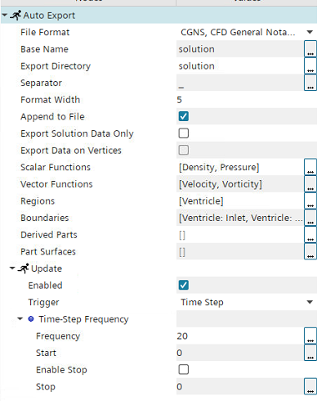
Step 5.2: Automatic Export
Tab: File → Auto Export
File Format: CGNS
Base Name: solution
Export Directory: solution
Separator: _
Scalar Functions: Density, Pressure
Vector Functions: Velocity, Vorticity
Regions: Ventricle
Boundaries: Inlet, Outlet, Wall
Update: Enabled Trigger: Time Step Frequency: 20
ModelFLOWs
Cardiac
Run

Slide 20
Step 5.3: Initialization & Run
Tools → Right click in Parameters → New → Scalar: T_Period = 0.001 s
Continua → Blood → Initial Conditions:
Pressure = 0 Pa
Velocity = [0.0, 0.0, 0.0] m/s
Stopping Criteria → Maximum Inner Iterations: (Enabled)
Maximum Inner Iterations: 30
Logical Rule: And
Stopping Criteria → Maximum Physical Time: (Enabled)
Maximum Physical Time: 5 * ${T_Period}
Logical Rule: And
ModelFLOWs
Cardiac
Run

Slide 21
Step 5.4: Initialization & Run
Tools → Data Mappers → Right click in Surface Data Mapper 1 → Map Data
Tab: Solution → Initialize Solution
Tab: Solution → Run
Everytime we Clear Solution or Restart Simulation, it is necessary to Map Data, Initialize and then Run
ModelFLOWs
Cardiac
Run

Slide 22
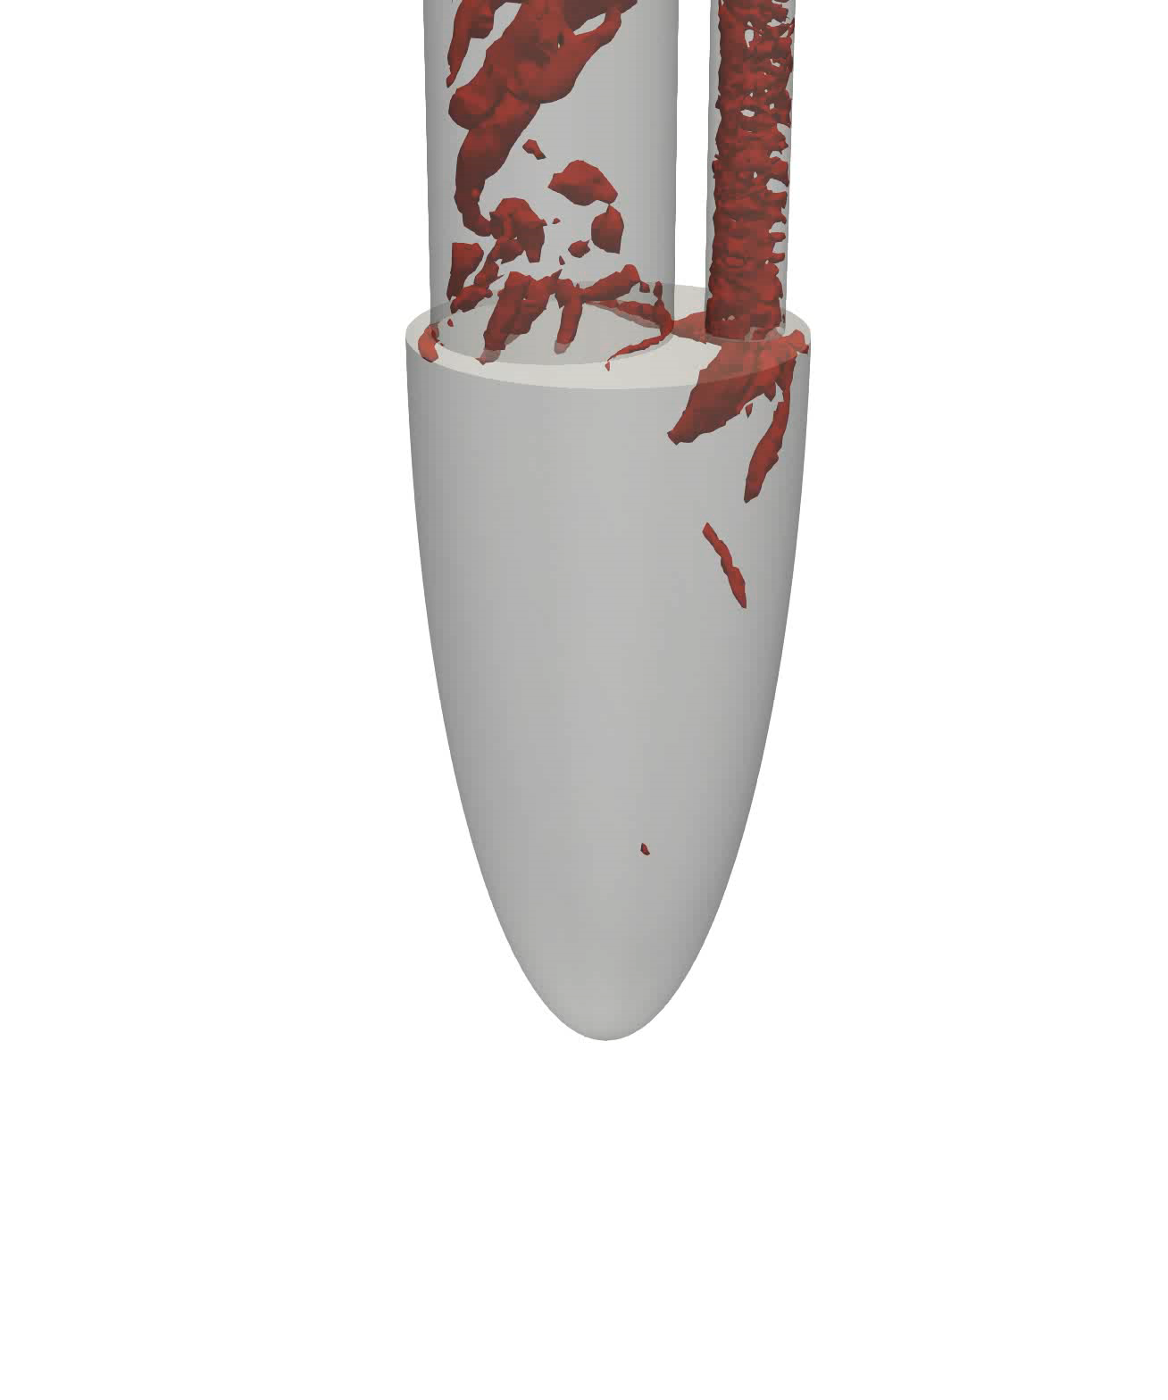
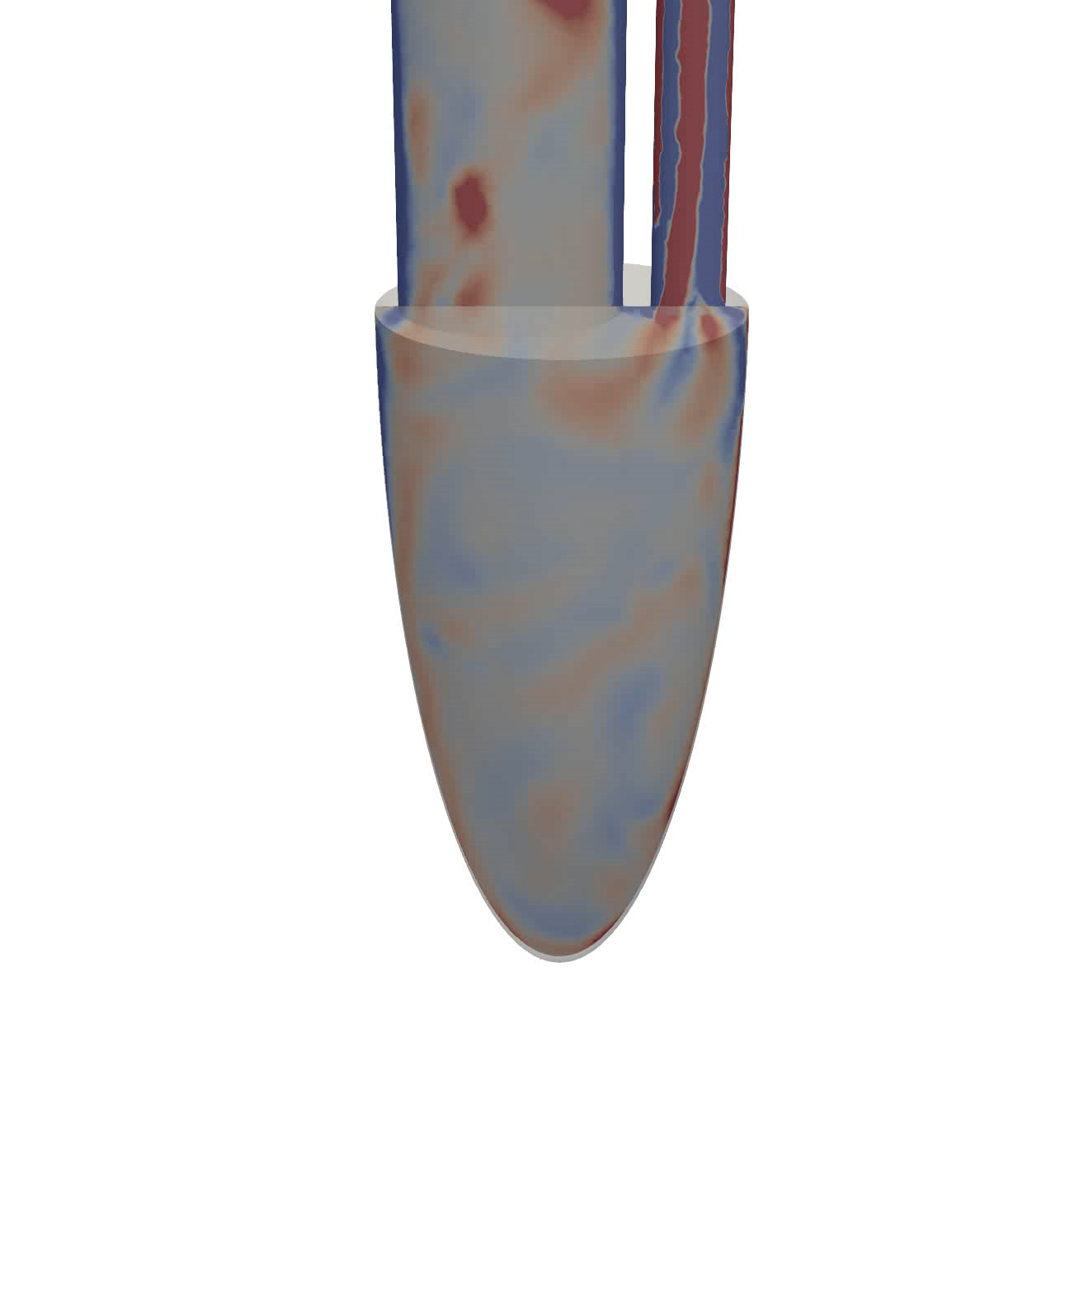
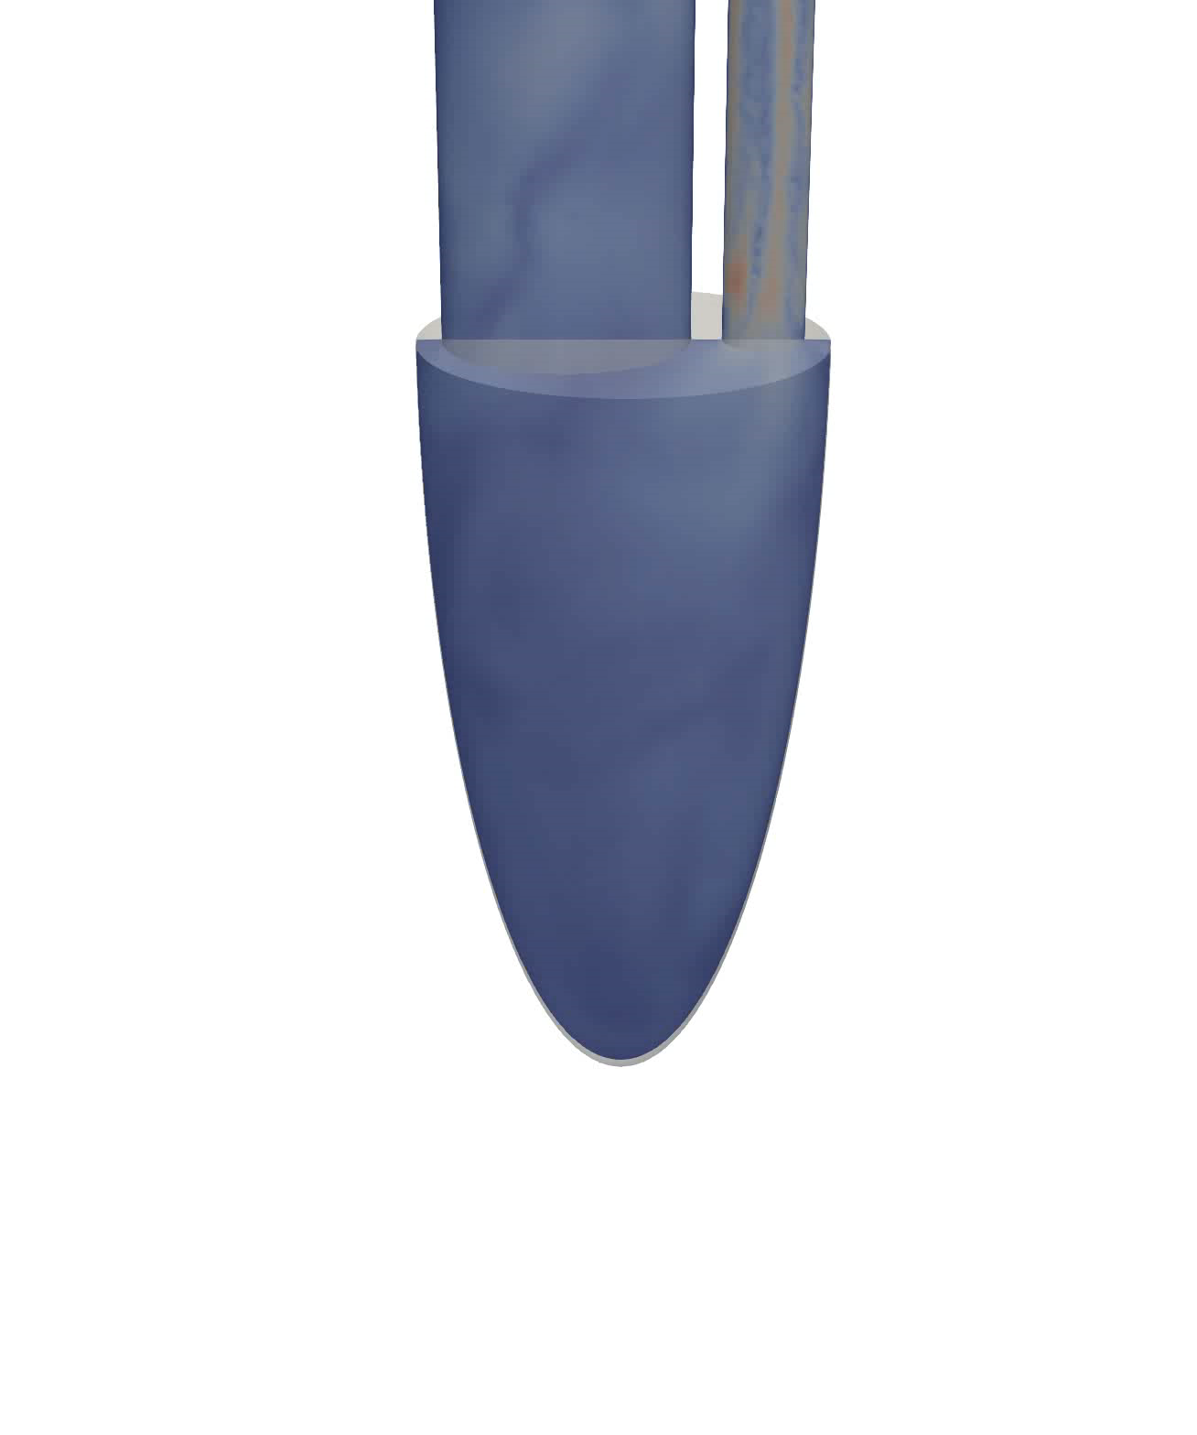
Q-Criterion
Vorticity
Velocity
Vortex ring formation, tilting, second smaller ring and outflow
Two swirls in both E and A waves of diastole and outflow in systole
Big recirculation in ventricle center, down to the apex.
ModelFLOWs
Cardiac

Slide 23


Any questions?
Look us up in our website:
https://modelflows.github.io/modelflowsapp/cardiacpathologydetection/
ModelFLOWs
Cardiac

